Slide 1

Database Servers
IT&C 515R – Applications of Cybersecurity Training

Slide 2
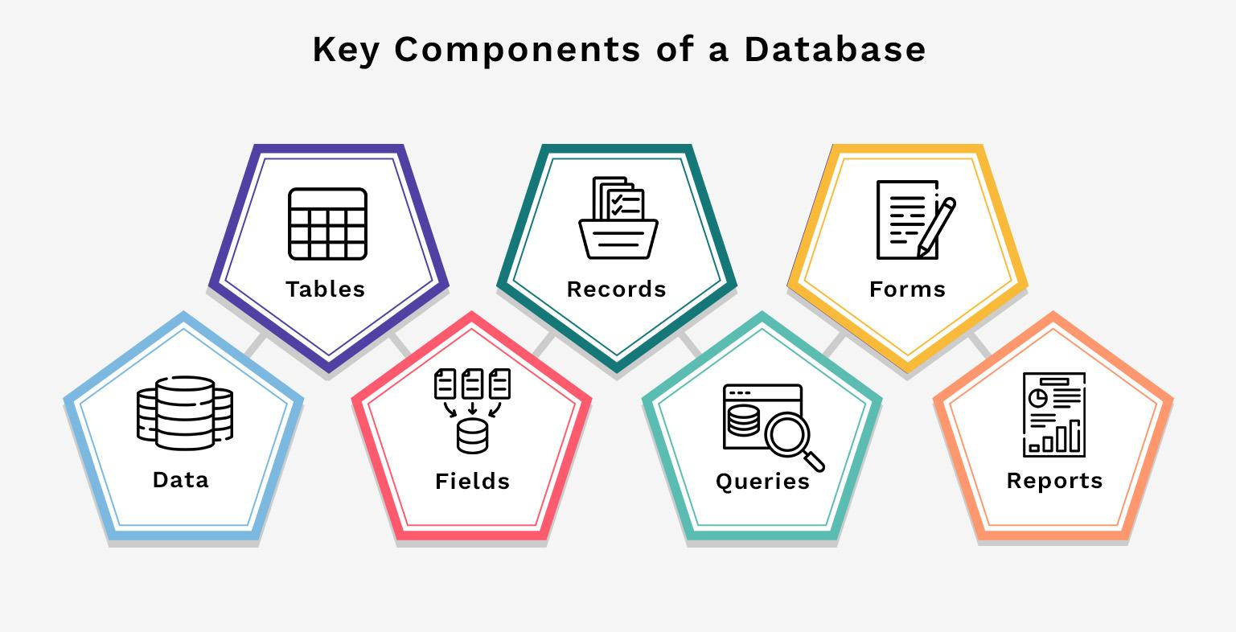

Slide 3
What is PostgreSQL?
An advanced, open-source relational database system.
ACID (Atomicity, Consistency, Isolation, and Durability) compliance
Support for JSON and NoSQL-like features
Use Cases
Web Applications
Data Warehousing
Geospatial Data (PostGIS)

Slide 4
Security Issues
Security Risks:
SQL Injection
Weak Passwords
Incorrect user permissions
Unauthorized/ old user accounts

